Slide 1




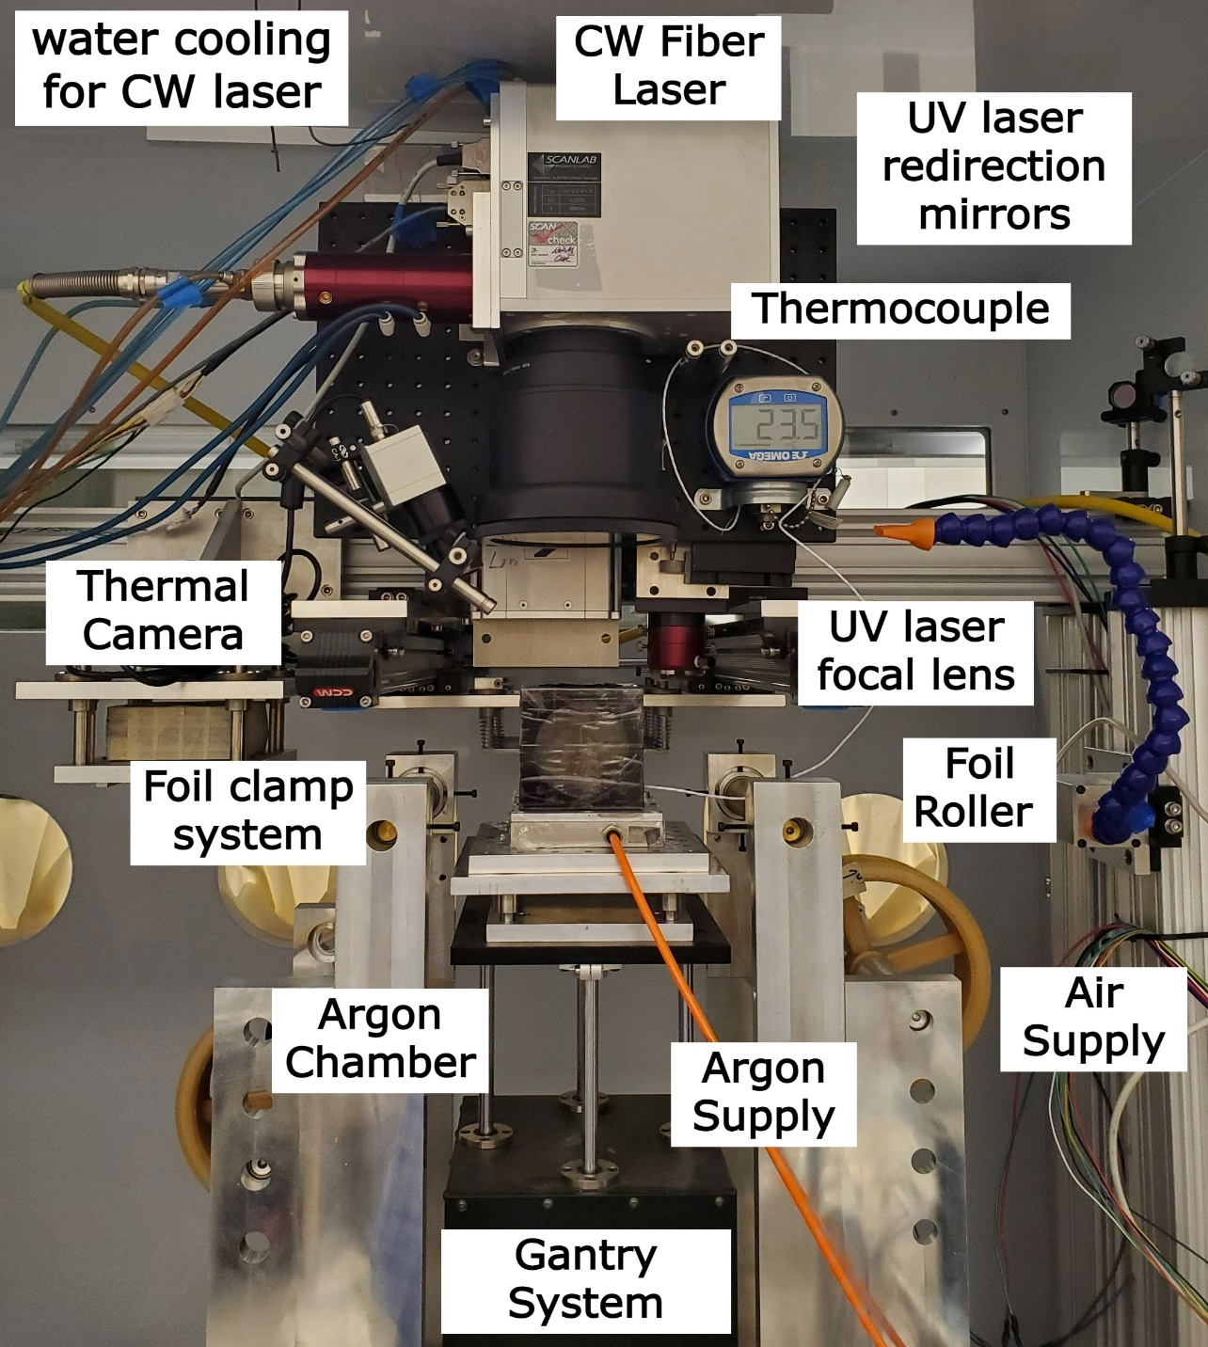
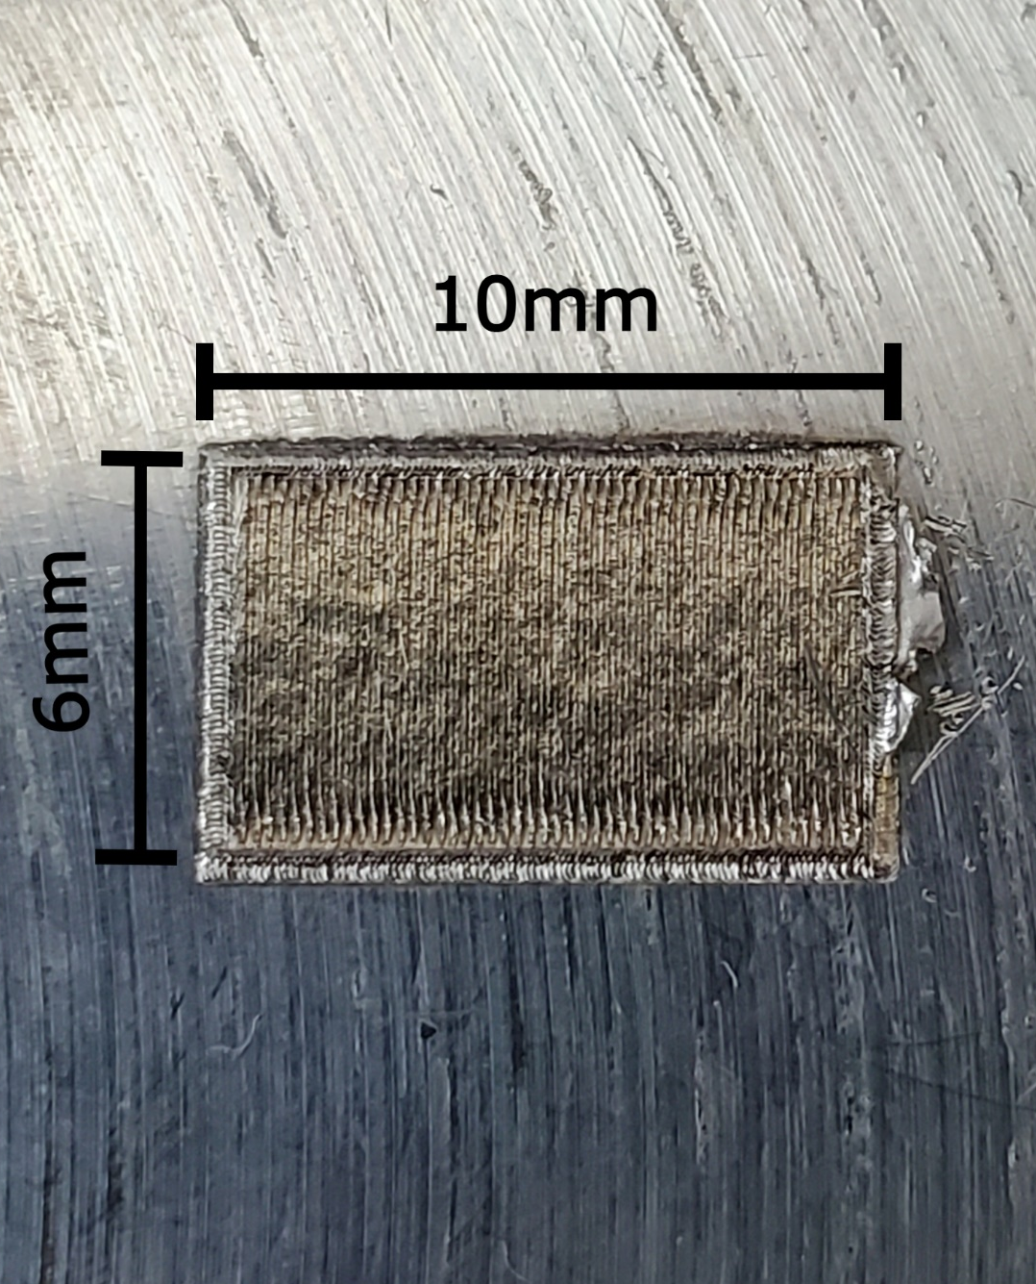
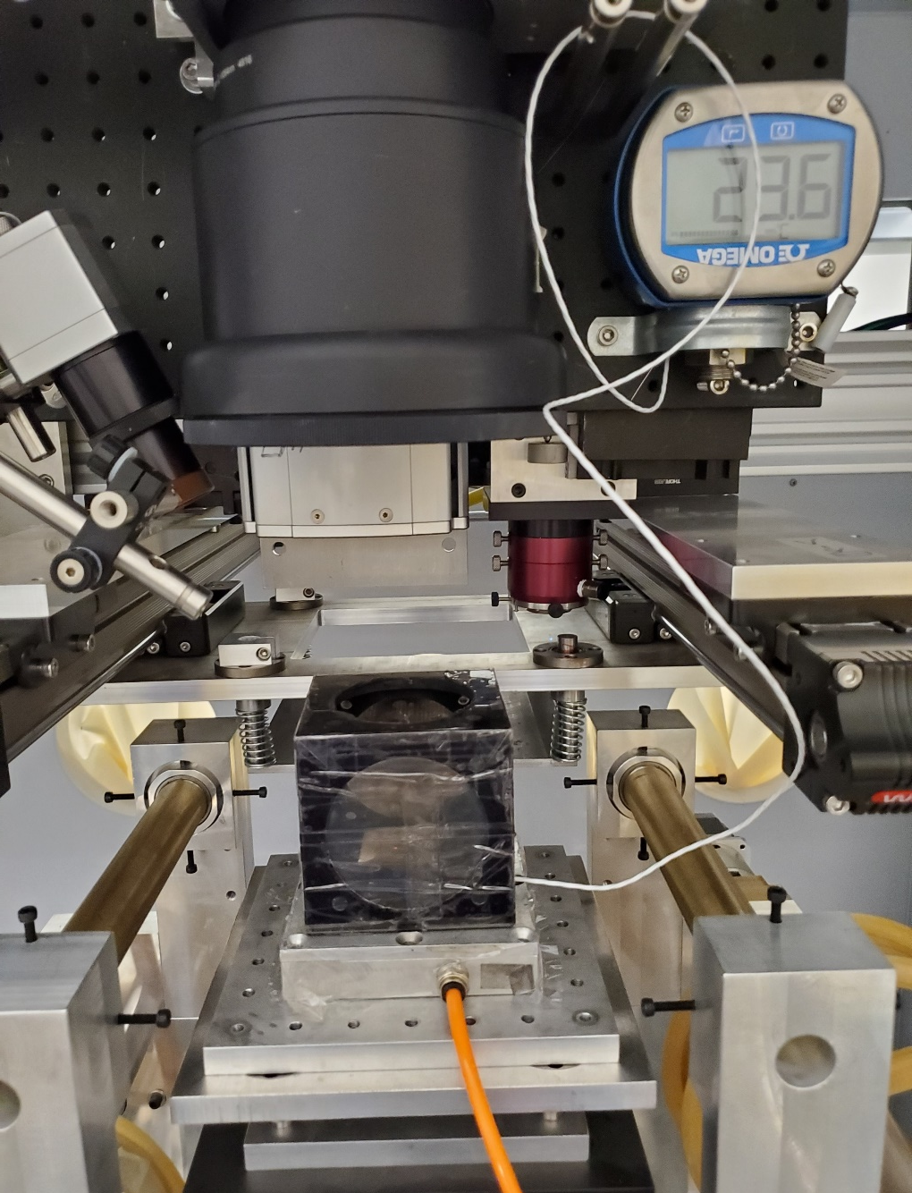
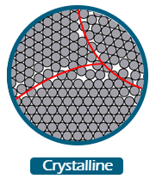
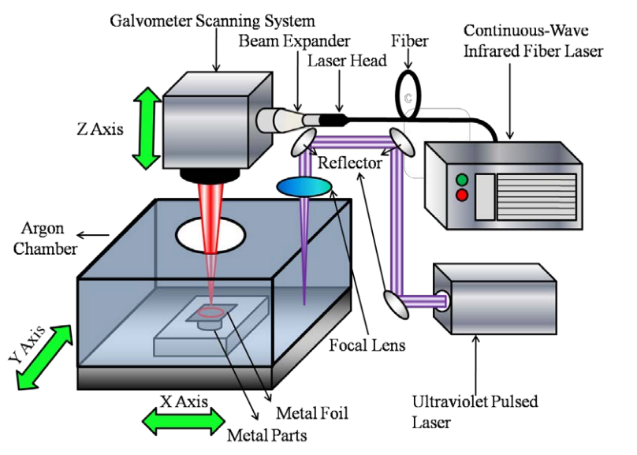
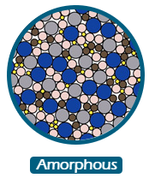
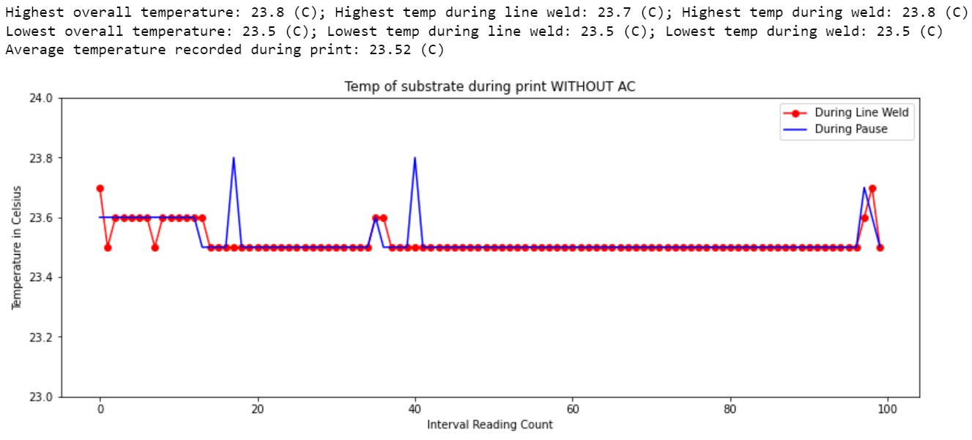
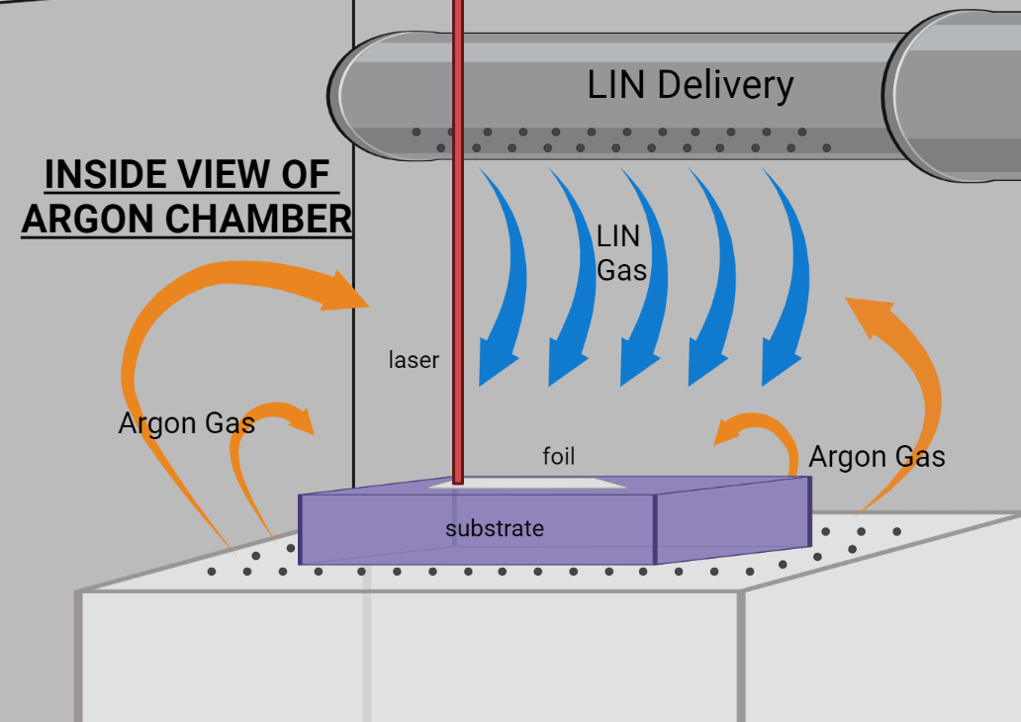
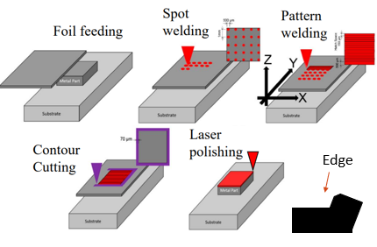
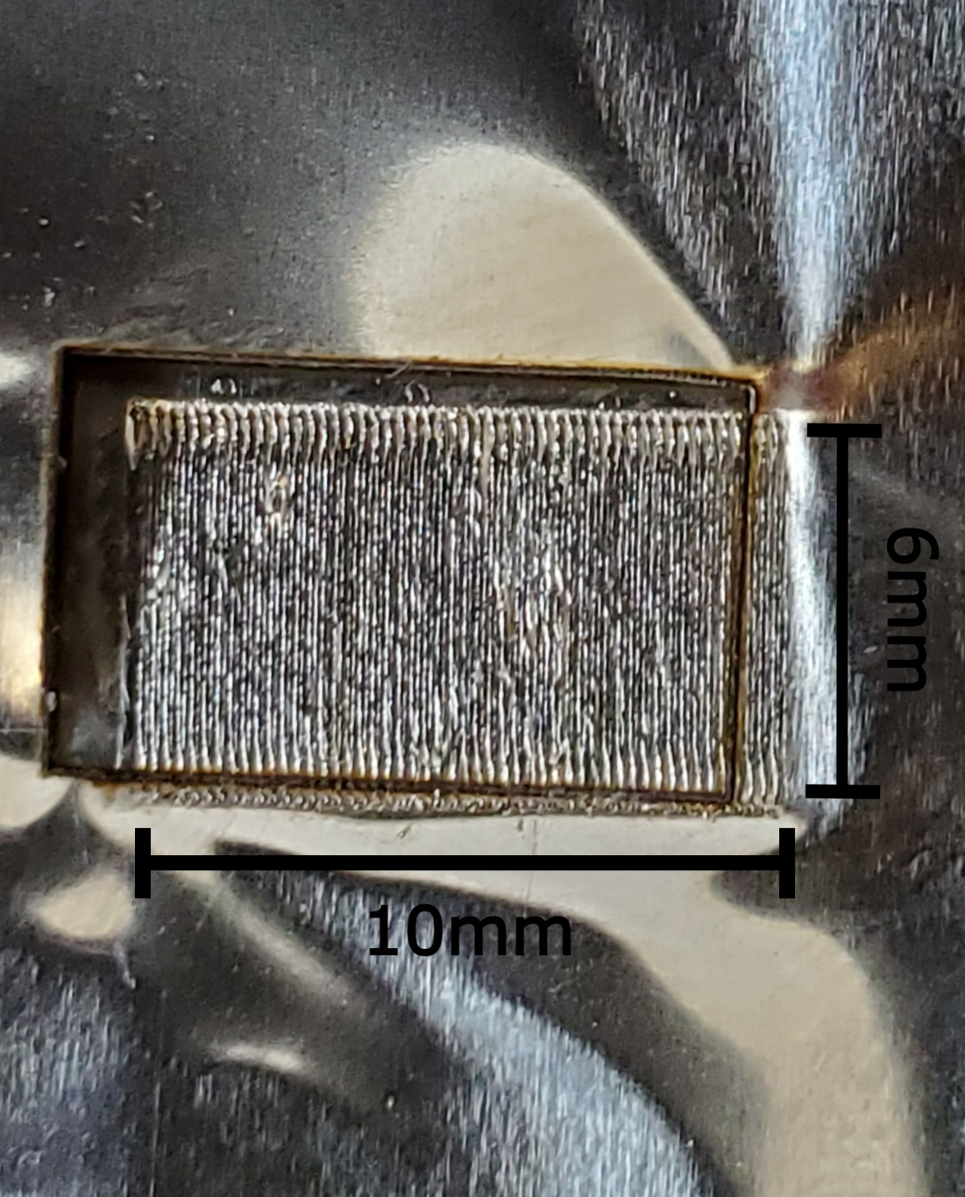
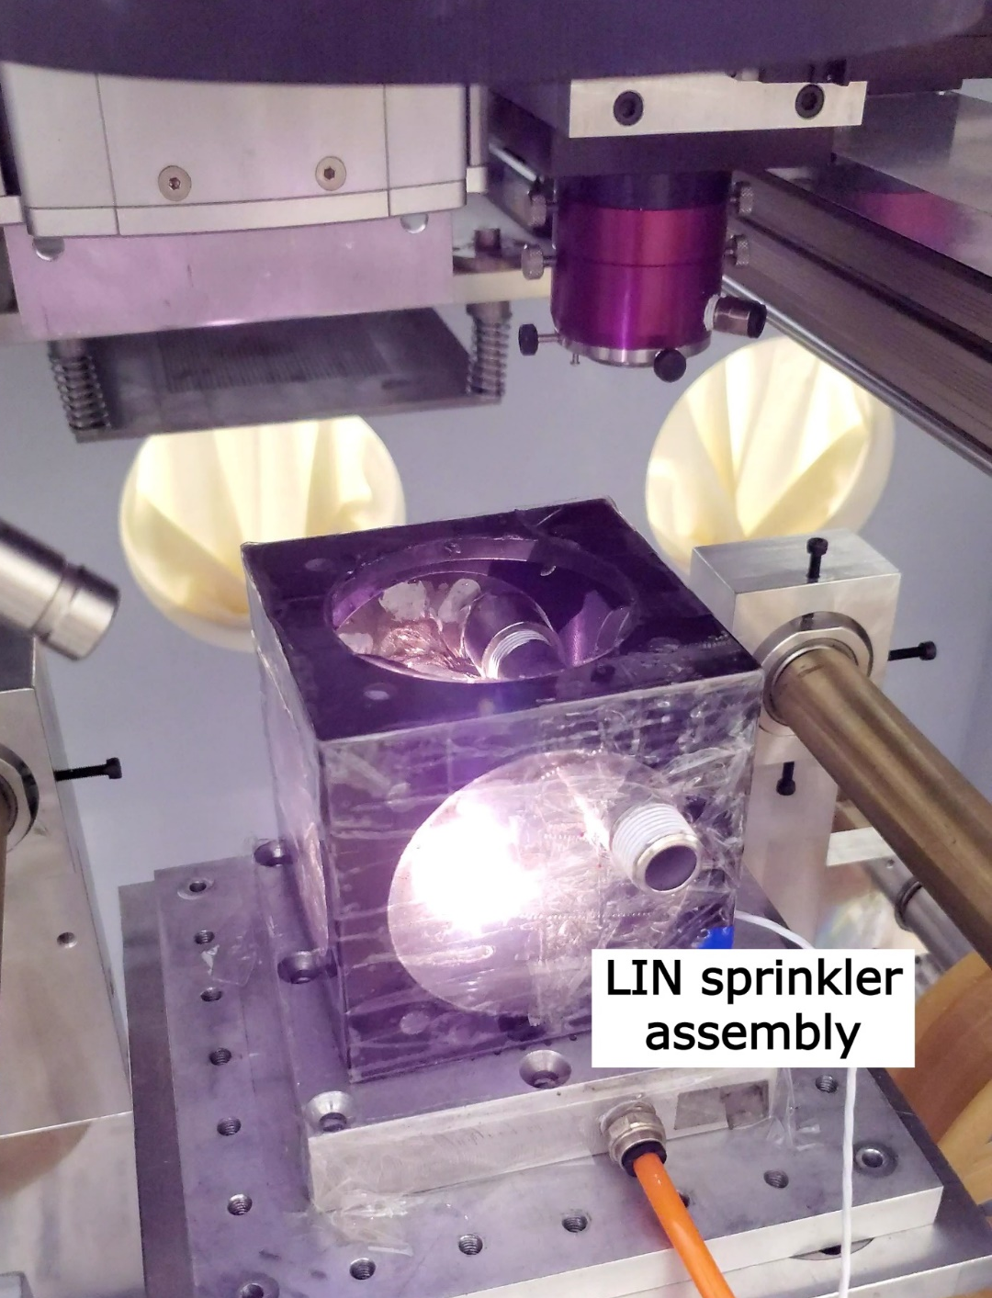
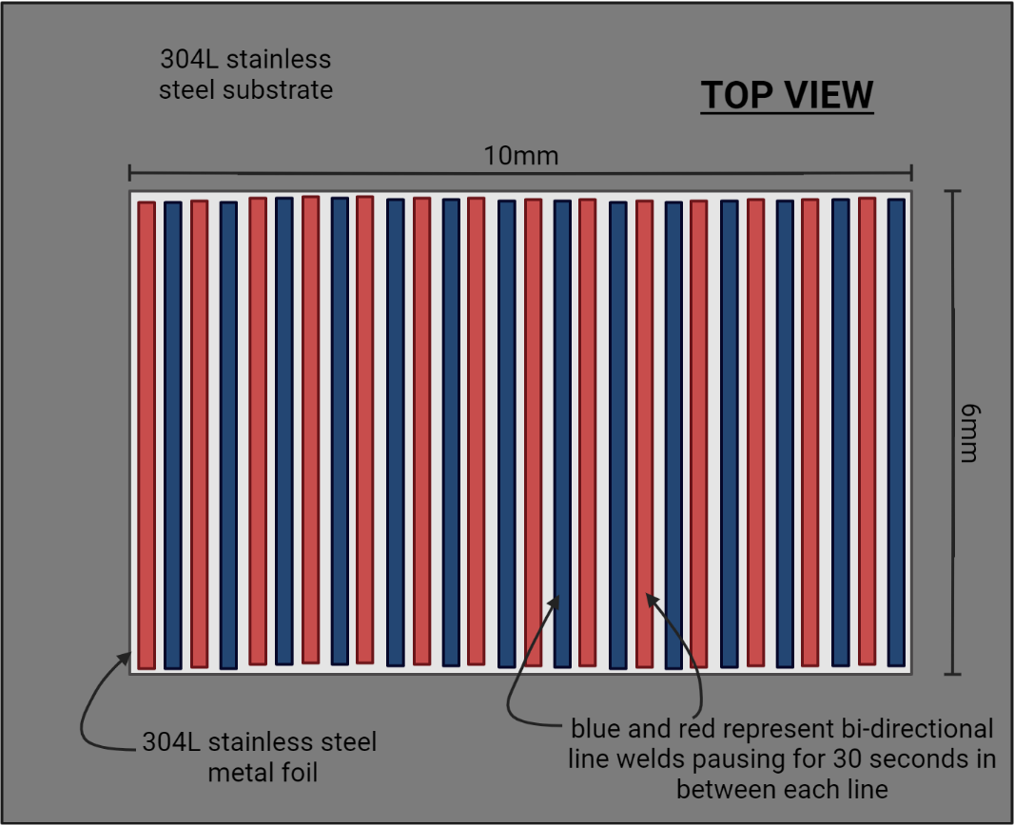
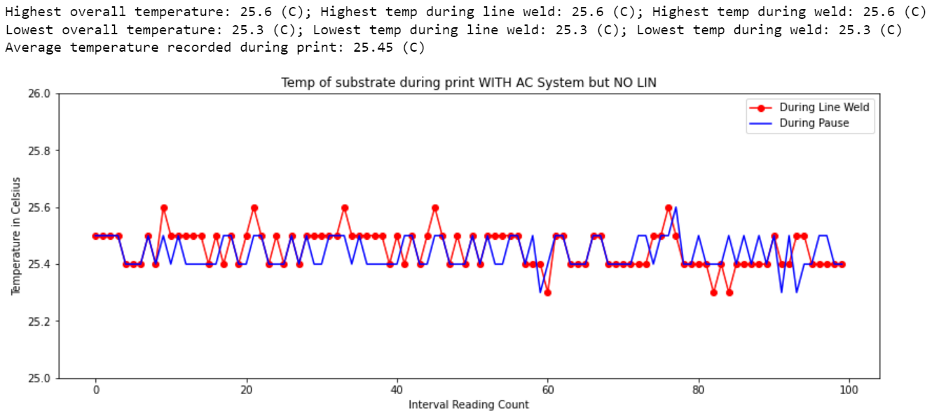
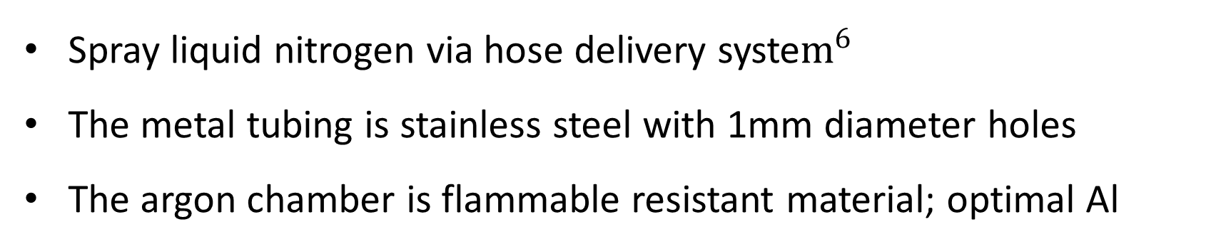
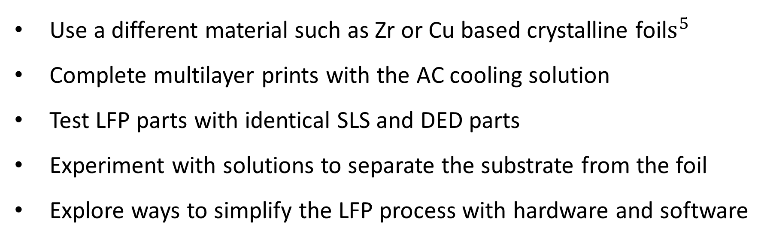
Metal Additive Manufacturing for Advanced Materials by Laser Foil Printing
Student: Fernando Sepulveda; Graduate Mentors: Hiep Pham, Tunay Turk; Advisors: Dr. Jonghyun Park, Dr. Ming Leu
Missouri S&T Department of Mechanical and Aerospace Engineering
INTRODUCTION
MATERIALS AND METHODS
RESULTS
CONCLUSIONS
Abstract Overview
Approach
Print WITHOUT Cooling System
Analysis
Novel AM technique, Laser Foil Printing (LFP) has potential to overcome challenges manufacturing Metallic Glass parts via bulk foil feedstock heat dissipation
MG parts characterized by amorphous structure with superior mechanical properties and geometric limitations
Focus on developing, implementing, and analyzing a cooling solutions’ ability to transform crystalline metal to amorphous metals
The prospective solution involves utilizing liquid nitrogen with a combination of pauses within the printing procedure to rapidly cool the metal foil (500 – 3000 K /s² CR).
First print was conducted without any additional cooling system
The actual wait between each line weld was 26s with 100-line pauses
First Print Sample
Suffered from a minor foil removal imperfection
Stable temp likely due to large substrate and small print sample
26s pauses led to a long print duration for a small-one layer print
The control setup has predicted printing outcome
Second Print Sample (Preliminary)
Uncalibrated foil cutting led to foil removal offset
Print volume has been reduced; can be improved with a superior sprinkler and box design/ homogenization.
The sprinkler system proved to be an effective cooling system
Thermocouple measurements indicate similar issues to print #1
Technique chosen for it’s high cooling rate potential
Liquid Nitrogen sprayed onto samples to rapidly reduce temperature of foil
Maintain standard printing procedures with added pauses and/ or cooling
Minimize external variables
Background
Final Remarks
Figure 6: Test Print 1 Sample
Figure 7: Sample 1 setup
The research consisted of understanding the LFP process, developing an active cooling solution, and analyzing the print samples for irregularity to determine cooling effectiveness.
The project was successful as a proof of concept for the active cooling system using LIN in the existing LFP system and establishing a testing/ analysis system for amorphous material.
Foreseeable applications:
The strength of the Bulk Metallic Glass
Environmental and Automated Process
Design
Figure 3: LFP setup with Thermocouple
Figure 1: Laser Foil Printing System³
Spray liquid nitrogen via hose delivery syste$m^{6}$
The metal tubing is stainless steel with 1mm diameter holes
The argon chamber is flammable resistant material; optimal Al
Versatile System
6 step build process
Laser 1: CW IR fiber (1,000W)
Laser 2: UV pulsed (10W)
Argon chamber used to minimize oxidation
Foil is welded with a layer-by-layer technique (100µm – 200µm thick)
Figure 8: Sample 1 temperature tracking plot graph
Future Work
Print WITH Cooling System (Preliminary)
Use a different material such as Zr or Cu based crystalline foil$s^{5}$
Complete multilayer prints with the AC cooling solution
Test LFP parts with identical SLS and DED parts
Experiment with solutions to separate the substrate from the foil
Explore ways to simplify the LFP process with hardware and software
Second print was conducted with LIN sprinkler but no LIN cooling
Wait time of 26s with 100-line pauses and LIN dispersal system
REFERENCES
Figure 4: LIN Cooling schematic
Shen, Yiyu, "Research on additive manufacturing of metallic glass alloy" (2018). Doctoral Dissertations. 2688.
Li, Yingqi, et al., “Building ZR-based Metallic Glass Part on Ti-6AL-4V substrate by Laser-Foil-Printing Additive Manufacturing”, (2018)
Hung, Chia-Hung, et al., “Mechanical Properties of 304l Metal Parts made by Laser-Foil Printing Process.” (2018)
Turk, Tunay, et al., “Methods of Automating the Laser-Foil-Printing Additive Manufacturing Process.” (2021)
Tang, Chunguang, and Peter Harrowell. “Anomalously Slow Crystal Growth of the Glass-Forming Alloy CuZr.” Nature Materials, vol. 12, no. 6, 2013, pp. 507–511.
O. Beteta and S. Ivanova, “Cool Down with Liquid Nitrogen,” Heat Transfer, 2015.
Methodology
[1]
[2]
[3]
[4]
[5]
[6]
Figure 2: Six step standard geometry building technique³
A 10mm x 6mm, one-layer 304L stainless steel rectangle print sample
Thermocouple attached to substrate to record temperature reading
The laser pauses 30 seconds between each bidirectional line weld
Samples analyzed through electron microscopy after procedure
OBJECTIVES
Goals
Aims at developing a rapid cooling system to implement in the LFP process to achieve amorphous structures
Identify what active cooling solution would be most effective when considering temperature management, characterization of material before and after, and difficulty to implement
Establish an effective means by which the production of amorphous geometries in the LFP process can be measured and developed
Figure 9: Test Print 1.5 Sample
Figure 10: Sample 1.5 setup
Prediction
ACKNOWLEDGMENTS
Experiment will be successful at identifying a productive cooling solution that can achieve the cooling rates required for amorphous structures. Expectation for future work and technological advancement.
The author gratefully thanks:
The Missouri University of Science and Technology faculty, mentors, and advisors for assistance and support
The Honeywell Kansas City National Security Campus for Funding
Figure 5: Sample prints schematic
Figure 11: Sample 1.5 temperature tracking plot graph
Presented at 2022 SFF Symposium

